Slide 1
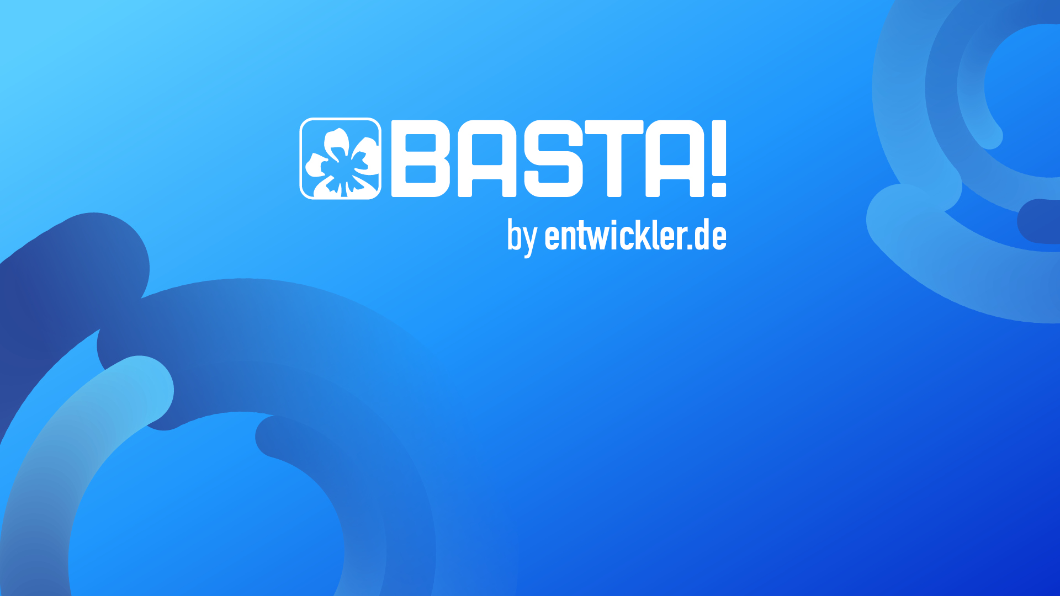
K8s Automation with Azure DevOps
A GitOps Approach w/o Tools
Roberto Freato | CTO @Retex – Azure MVP - Author

Slide 2
Few assumptions
Kubernetes is important crucial for modern applications
DevOps is the main connection between production and delivery
Some teams may not yet have developed DevOps skills
Various tools exist between start line and final GitOps outcomes
Always start simple

Slide 3
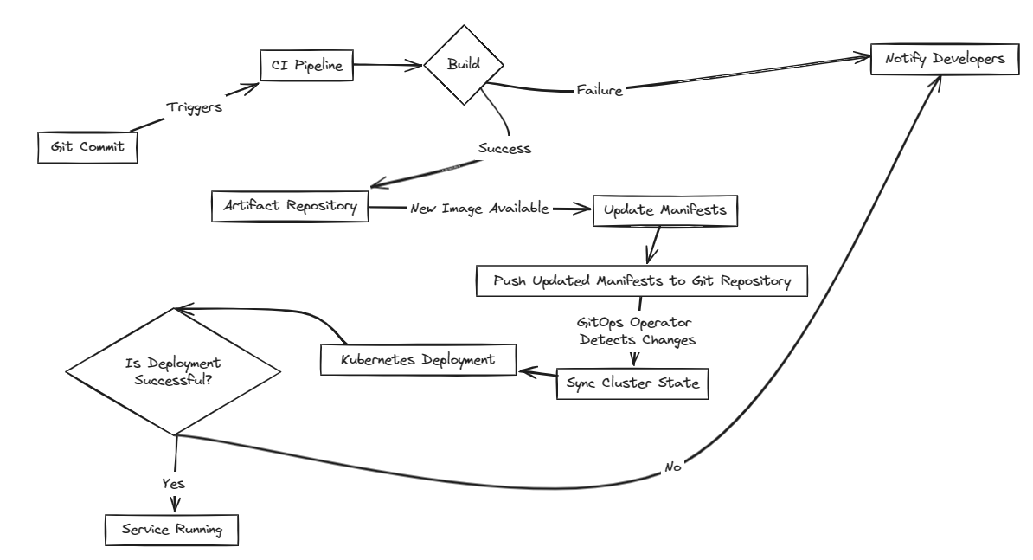
The desired process

Slide 4
Is your team docker aware?

Slide 5
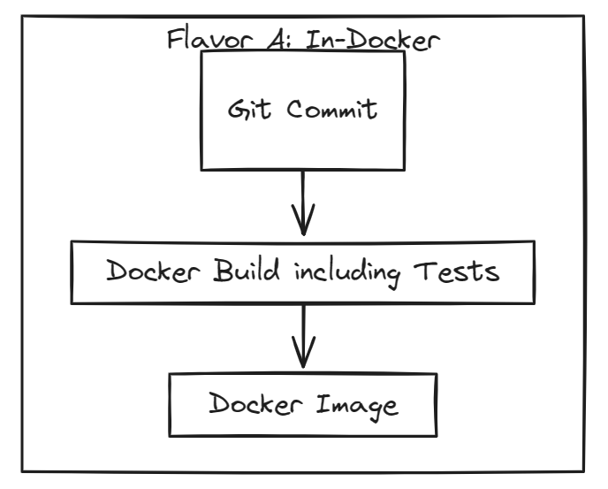

They are docker-aware
YOU commit the code and Dockerfile
BOT picks the commit, builds and publishes the docker image
Inside the Dockerfile there is everything to build, test and run the app

Slide 6
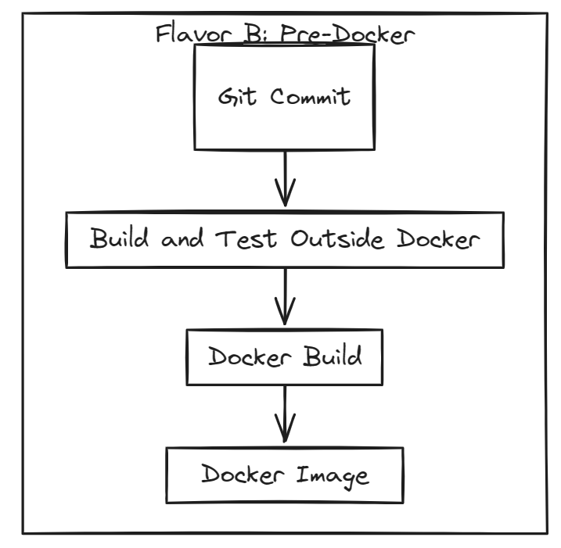


They are NOT SO docker-aware
YOU commit the code
BOT picks the commit, builds it, optionally runs the test suite and deposits the build artifact
BOT picks the build artifact, as long as a Dockerfile to run it (simpler) to build and publish a docker image

Slide 7
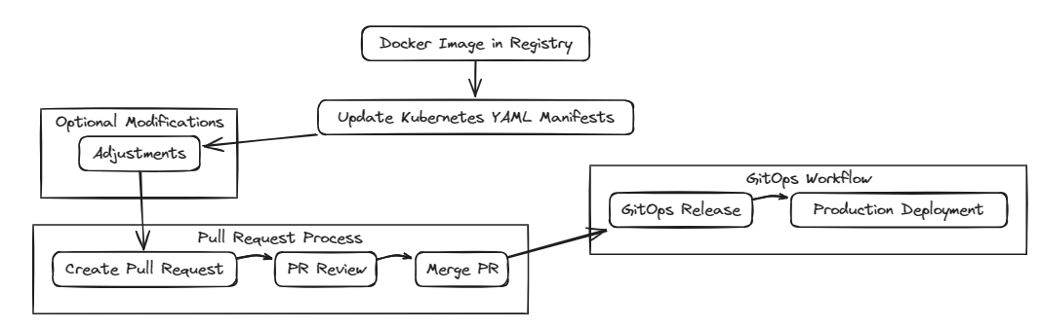
What’s after

Slide 8

What’s after

Slide 9

What’s after

Slide 10
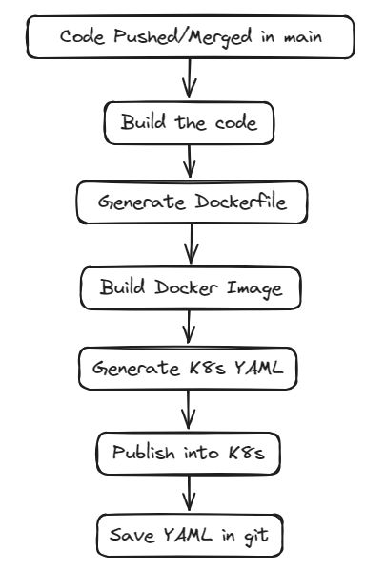
Let’s start simple
With a monolith

Slide 11
DEMO
Demo application | Kubernetes | Monolith process

Slide 12
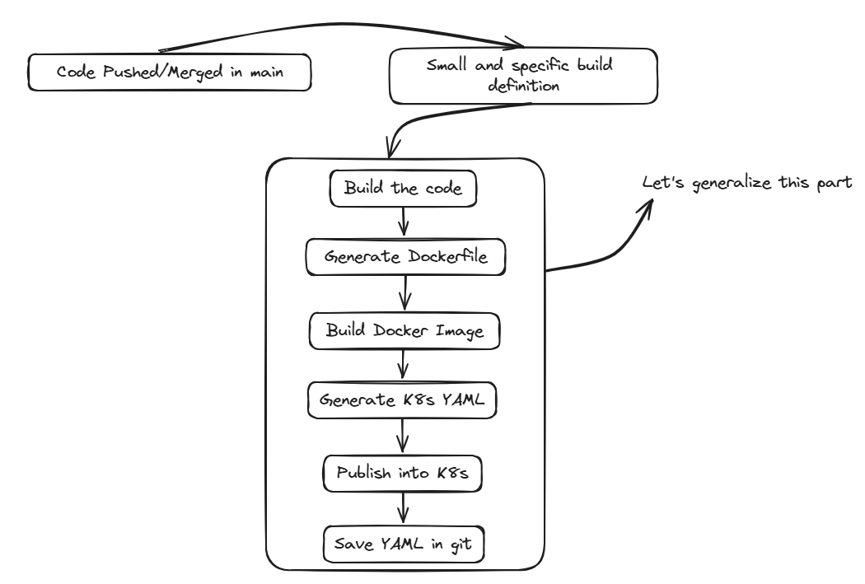
Let’s generalize it
With YAML

Slide 13
What’s next

Slide 14
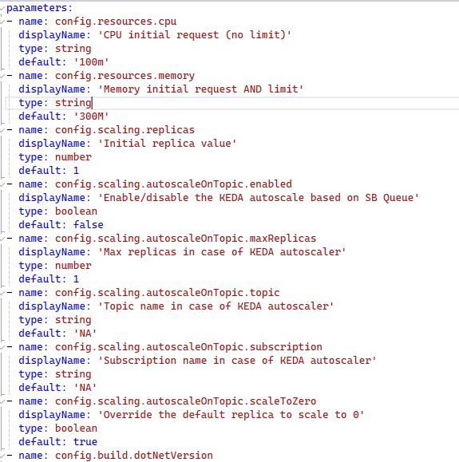
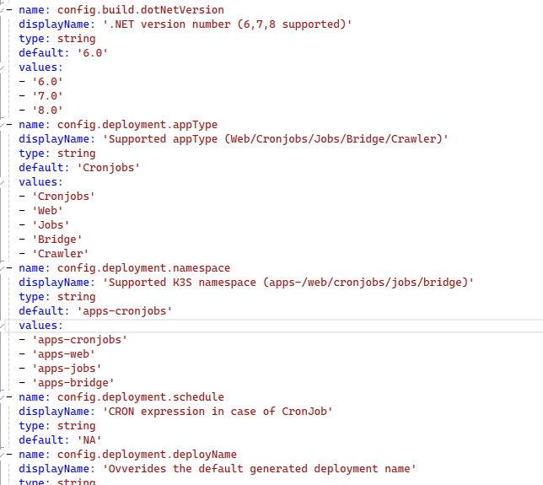
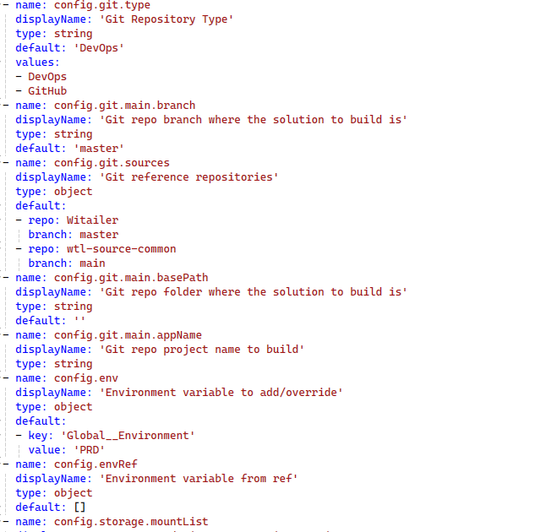
Parameters

Slide 15
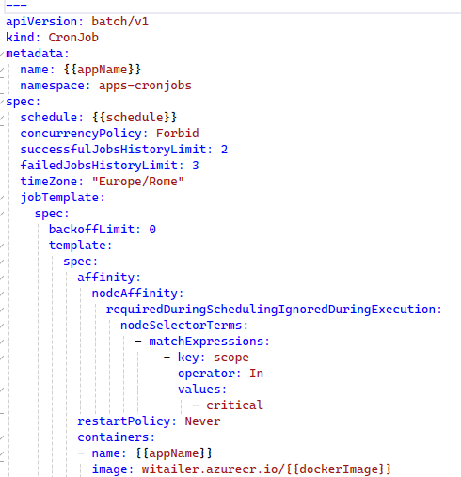
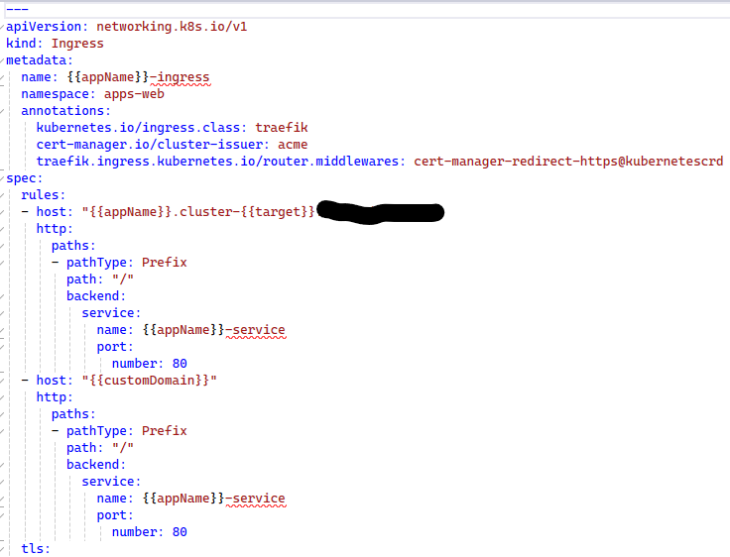
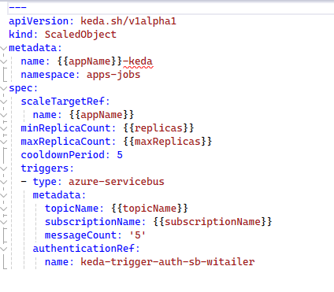
YAML additions

Slide 16
Takeaways
To build DevOps skills in your team, start simple
Complicate things to scale
When ready
Eventually introduce tools when your process is mature
HELM
Kustomize
Flux | ArgoCD

Slide 17
K8s Automation with Azure DevOps
A GitOps Approach w/o Tools
Roberto Freato | CTO @Retex – Azure MVP - Author

